Slide 1
4:8-22

Slide 2
4:8-22
2 Timothy 4:8-22 ~ ⁸ Finally, there is laid up for me the crown of righteousness, which the Lord, the righteous Judge, will give to me on that Day, and not to me only but also to all who have loved His appearing.
⁹ Be diligent to come to me quickly; ¹⁰ for Demas has forsaken me, having loved this present world, and has departed for Thessalonica – Crescens for Galatia, Titus for Dalmatia. ¹¹ Only Luke is with me. Get Mark and bring him with you, for he is useful to me for ministry. ¹² And Tychicus I have sent to Ephesus. ¹³ Bring the cloak that I left with Carpus at Troas when you come – and the books, especially the parchments.

Slide 3
4:8-22
2 Timothy 4:8-22 ~ ¹⁴ Alexander the coppersmith did me much harm. May the Lord repay him according to his works. ¹⁵ You also must beware of him, for he has greatly resisted our words.
¹⁶ At my first defense no one stood with me, but all forsook me. May it not be charged against them.
¹⁷ But the Lord stood with me and strengthened me, so that the message might be preached fully through me, and that all the Gentiles might hear. Also I was delivered out of the mouth of the lion. ¹⁸ And the Lord will deliver me from every evil work and preserve me for His heavenly kingdom.

Slide 4
4:8-22
2 Timothy 1:1-12 ~ To Him be glory forever and ever. Amen!
¹⁹ Greet Prisca and Aquila, and the household of Onesiphorus. ²⁰ Erastus stayed in Corinth, but Trophimus I have left in Miletus sick.
²¹ Do your utmost to come before winter.
Eubulus greets you, as well as Pudens, Linus, Claudia, and all the brethren.
²² The Lord Jesus Christ be with your spirit. Grace be with you.

Slide 5
4:8-22

Slide 6
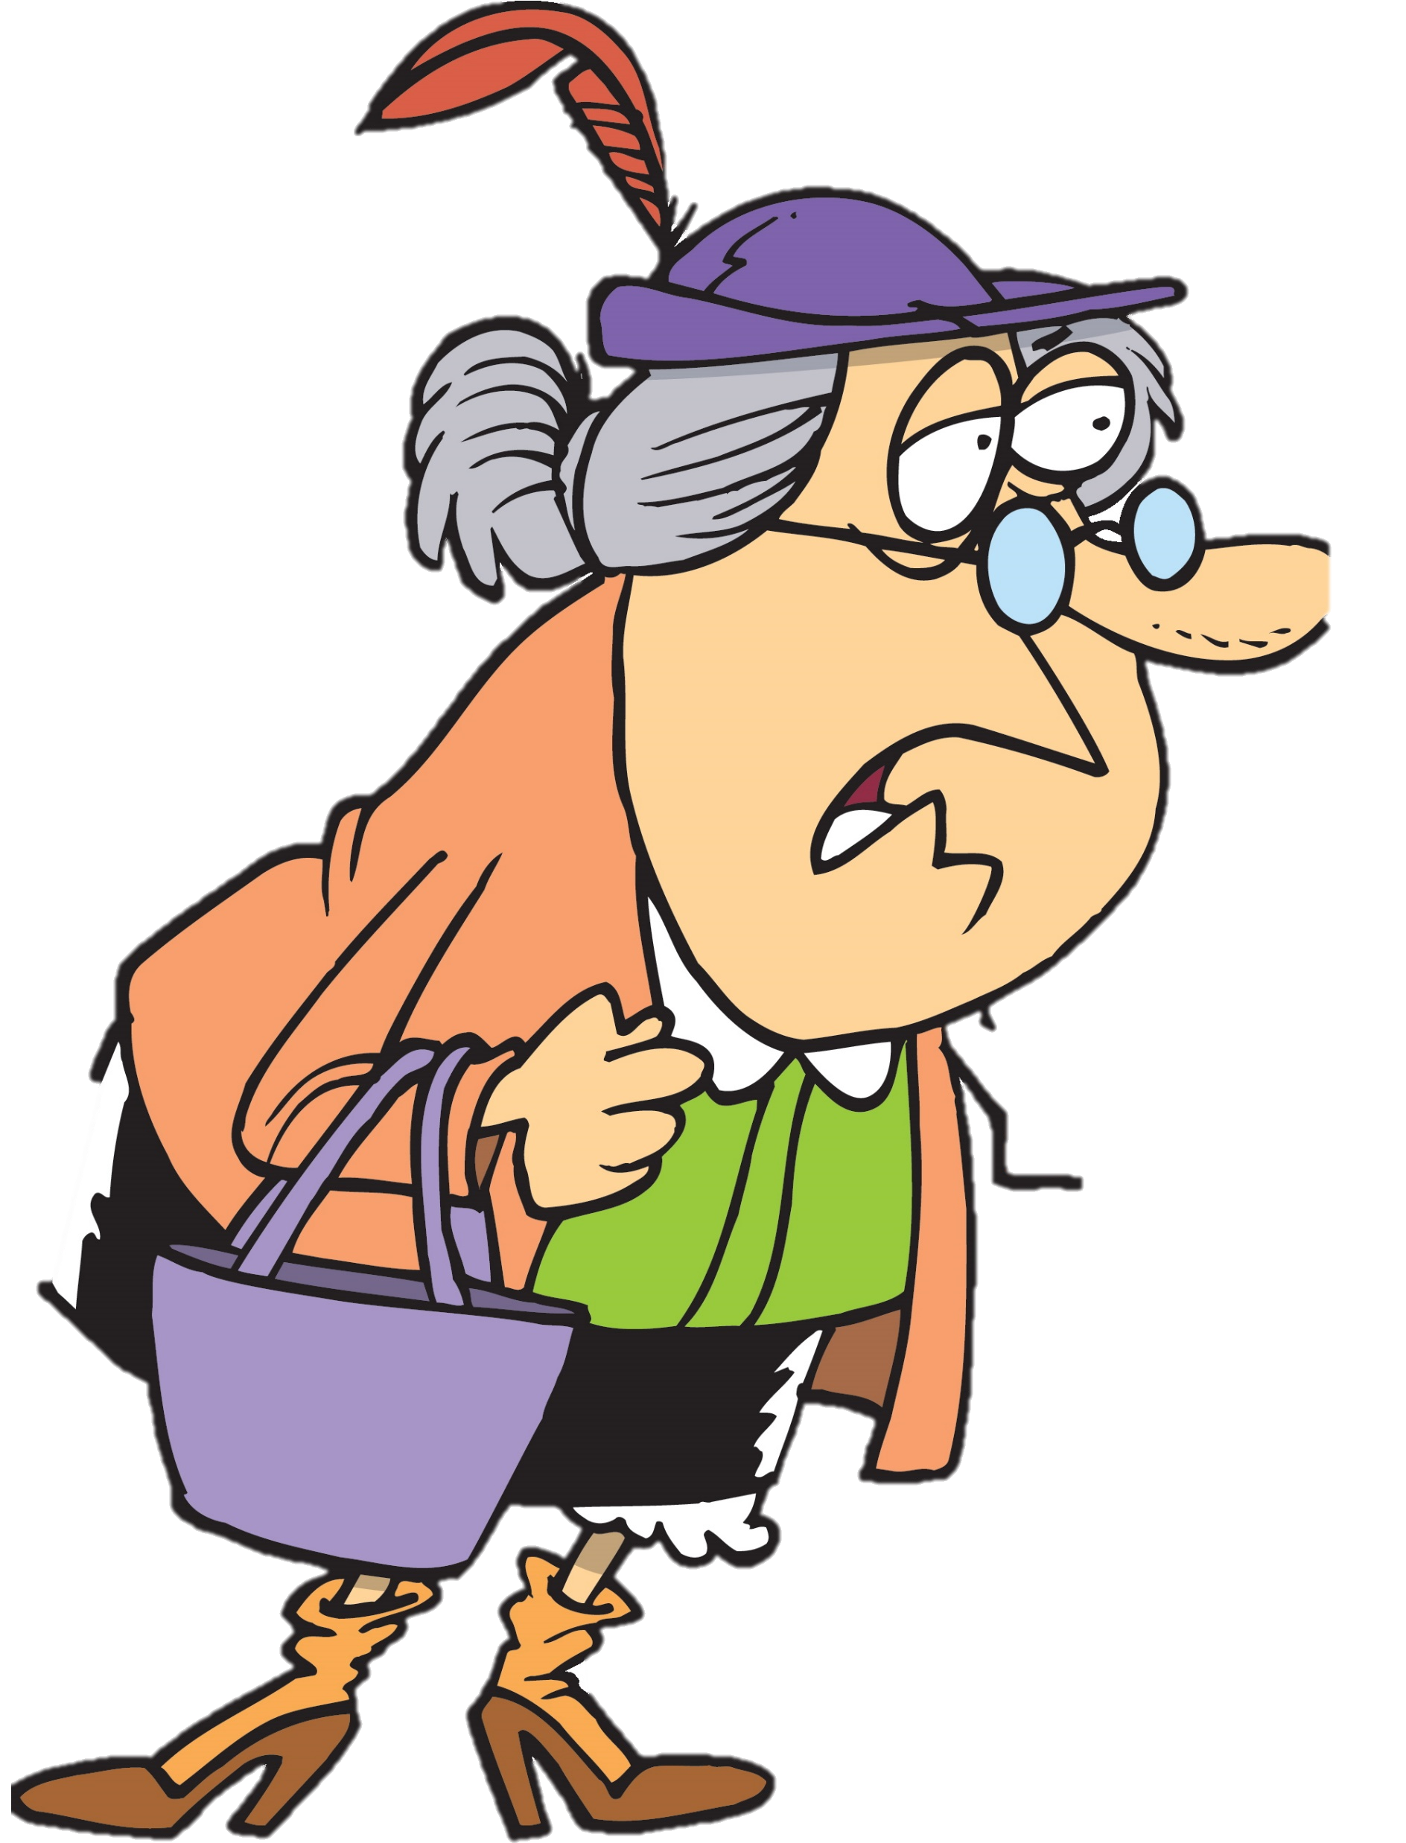
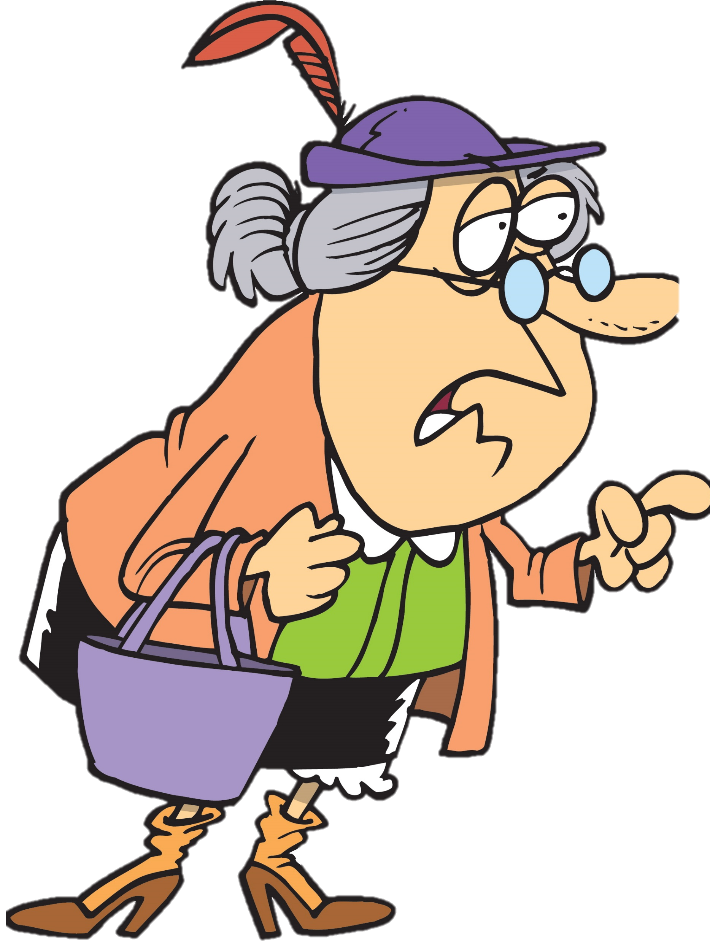
4:8-22
And what do you think is the best thing about being 104?
No peer pressure

Slide 7
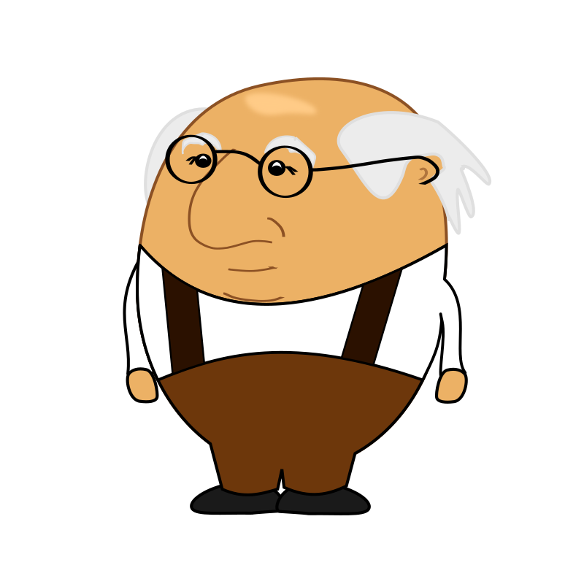
4:8-22
I’m half blind,
can’t hear anything quieter
than a jet engine, take 40 different medications that
make me dizzy, winded,
and subject to blackouts.
Have bouts with
dementia. Have poor circulation; hardly feel my hands and feet anymore.
I’ve had two bypass surgeries, a hip replacement, new knees, fought prostate cancer and diabetes.
Can’t remember if I’m 85
or 92. Have lost all my friends.
Although I have figured out how to prevent sagging …
It’s scary when you start making the same noises as your coffee maker …
I tell you – growing old ain’t for sissies.
… and I have an espresso machine
I tell you – growing old ain’t for sissies.
My memory’s not as sharp as it used to be.
Just eat until all the wrinkles fill out.
Also, my memory’s not as sharp as it used to be.
But, thankfully, I still have
my driver’s license.

Slide 8
4:8-22

Slide 9
4:8-22
crown ~ stephanos – laurel wreath crown
2 Cor. 5:10 ~ For we must all appear before the judgment seat of Christ, that each one may receive the things done in the body, according to what he has done, whether good or bad.

Slide 10
4:8-22
crown of life
Jam. 1:12 ~ Blessed is the man who endures temptation; for when he has been approved, he will receive the crown of life which the Lord has promised to those who love Him.

Slide 11
4:8-22
crown that is imperishable
1 Cor. 9:25 ~ And everyone who competes for the prize is temperate in all things. Now they do it to obtain a perishable crown, but we for an imperishable crown.

Slide 12
4:8-22
crown of rejoicing
1 Thess. 2:19 ~ For what is our hope, or joy, or crown of rejoicing? Is it not even you in the presence of our Lord Jesus Christ at His coming?

Slide 13
4:8-22
crown of glory
1 Pet. 5:4 ~ and when the Chief Shepherd appears, you will receive the crown of glory that does not fade away.

Slide 14
4:8-22
crown of righteousness
2 Tim. 4:8 ~ Finally, there is laid up for me the crown of righteousness, which the Lord, the righteous Judge, will give to me on that Day, and not to me only but also to all who have loved His appearing.

Slide 15
4:8-22

Slide 16
4:8-22
Rev. 4:10 ~ the twenty-four elders fall down before Him who sits on the throne and worship Him who lives forever and ever, and cast their crowns before the throne …

Slide 17
4:8-22
Rev. 5:8-10 ~ ⁸ Now when He had taken the scroll, the four living creatures and the twenty-four elders fell down before the Lamb, each having a harp, and golden bowls full of incense, which are the prayers of the saints. ⁹ And they sang a new song, saying:
“You are worthy to take the scroll,
And to open its seals;
For You were slain,

Slide 18
4:8-22
Rev. 5:8-10 ~ And have redeemed us to God by Your blood
Out of every tribe and tongue and people and nation,
¹⁰ And have made us kings and priests to our God;
And we shall reign on the earth.”

Slide 19
4:8-22
not
diadēma
Gold is the currency of the world
stephanos
Gold is considered asphalt in heaven
The laurel wreath is the currency of heaven
This Photo by Unknown Author is licensed under CC BY-SA

Slide 20
4:8-22

Slide 21
4:8-22
Demas ~ governor of the people – mentioned in the closing of Colossians (4:14) and Philemon (1:24)
Crescens ~ growing – according to tradition, one of the 70 missionaries sent out by Jesus (Luke 10:1-12)
Titus ~ nurse – pastor to the island of Crete

Slide 22
4:8-22

Slide 23
4:8-22
Matt. 21:28-31 ~ ²⁸ “… A man had two sons, and he came to the first and said, ‘Son, go, work today in my vineyard.’ ²⁹ He answered and said, ‘I will not,’ but afterward he regretted it and went. ³⁰ Then he came to the second and said likewise. And he answered and said, ‘I go, sir,’ but he did not go. ³¹ Which of the two did the will of his father?”
They said to Him, “The first.”
Jesus said to them, “Assuredly, I say to you that tax collectors and harlots enter the kingdom of God before you.”

Slide 24
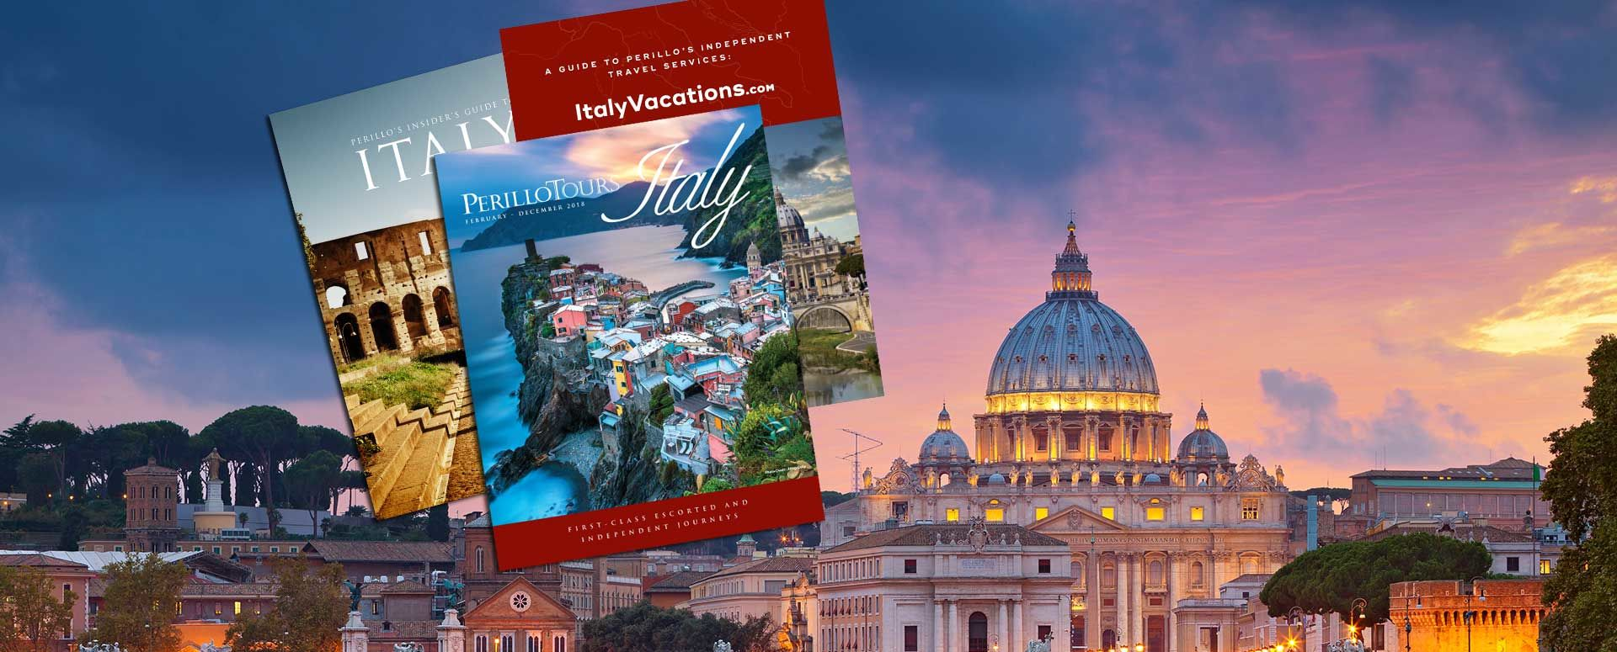
4:8-22

Slide 25
4:8-22

Slide 26
4:8-22
books ~ biblion – literally, little book
parchments ~ membrana – made from animal skins

Slide 27
4:8-22

Slide 28
4:8-22
first defense ~ apologia
1 Pet. 3:15b ~ always be ready to give a defense to everyone who asks you a reason for the hope that is in you, with meekness and fear;
Vine’s Expository Dictionary of NT Words ~ verbal defense, a speech in defense

Slide 29
4:8-22
Nero murdered Agrippina
Rome burned
Nero assassinated
AD 60
AD 62
AD 64
AD 66
AD 68
Paul’s 1st imprisonment
1 Timothy
Rearrested
2 Timothy

Slide 30
4:8-22

Slide 31
4:8-22
Eubulus ~ well-intended
Pudens ~ modest – according to tradition. the son of a senator; a saint in the Orthodox Church
Linus ~ linen – is believed to be the 1st bishop of Rome (Irenaeus, Eusebius)
In Roman Catholicism, he’s the 2nd bishop (pope) and a saint
Claudia ~ lame – is believed to be the mother of Linus
Daughter of a British king (deposed by the Romans)

Slide 32
4:8-22

Slide 33
4:8-22
Grammar lesson:
y’all ~ 2nd person singular
all y’all ~ 2nd person plural
Merrihew Standard Version ~ The Lord Jesus Christ be with y’all’s spirit. Grace be with all y’all. So be it.

Slide 34
4:8-22

